Slide 1

MACHINE
INTELLIGENCE
EXPECTATION MAXIMIZATION
K.S.Srinivas
Department of Computer Science and Engineering

Slide 2
MACHINE
INTELLIGENCE
EXPECTATION MAXIMIZATION
K.S.Srinivas
Department of Computer Science
and Engineering

Slide 3

Machine Intelligence
Unit III
Expectation Maximization
Srinivas K.S
Department of Computer Science

Slide 4

Expectation Maximization
Maximum likelihood estimation is an approach to density estimation for a dataset by searching across probability distributions and their parameters.
It is a general and effective approach that underlies many machine learning algorithms, although it requires that the training dataset is complete, e.g. all relevant interacting random variables are present.
Maximum likelihood becomes intractable if there are variables that interact with those in the dataset but were hidden or not observed, so-called latent variables.
The expectation-maximization algorithm is an approach for performing maximum likelihood estimation in the presence of latent variables
It does this by f
estimating the values for the latent variables, (E)
then optimizing the model(M),
then repeating these two steps until convergence.

Slide 5
Unsupervised Learning and EM
A central application of unsupervised learning is in the field of density estimation.
We will cover unsupervised learning in Unit 4 some 8 hours from now – but lets understand one of the simplest unsupervised learning algorithm to set the context for expectation maximization
K-Means clustering

Slide 6
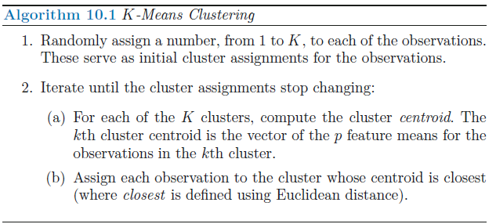

K-Means Clustering
K-means clustering is a simple and elegant approach for partitioning a data set into K distinct, non-overlapping clusters.
To perform K-means clustering, we must first specify the desired number of clusters K
K-means algorithm will assign each observation to exactly one of the K clusters

Slide 7
K-Means Clustering
Let C1, . . ., CK denote sets containing the indices of the observations in each cluster
They must satisfy 2 properties
1. C1 ∪ C2 ∪ . . . ∪ CK = {1, . . ., n}. In other words, each observation
belongs to at least one of the K clusters.
2. Ck ∩ Ck’ = ∅ for all k = k’. In other words, the clusters are nonoverlapping: no observation belongs to more than one cluster.

Slide 8
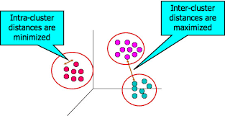


K-Means Clustering
The idea behind K-means clustering is that a good clustering is one for which the within-cluster variation is as small as possible.
The within-cluster variation for cluster Ck is a measure W(Ck) of the amount by which the observations within a cluster differ from each other.
In words, this formula says that we want to partition the observations into K clusters such that the total within-cluster variation, summed over all K clusters, is as small as possible
The intra-cluster distance is measured using the Euclidian distance between pair wise instances in the cluster

Slide 9
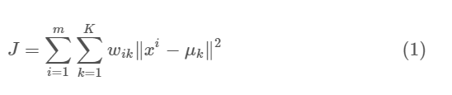
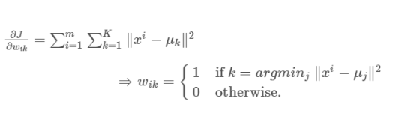
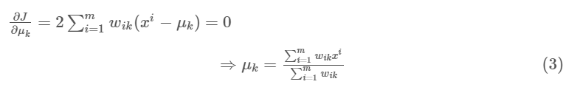
Expectation Maximization of K-Means
The E-step is assigning the data points to the closest cluster.
The M-step is computing the centroid of each cluster.
Lets prove that convergence is guaranteed
E-Step
where wik=1 for data point xi if it belongs to cluster k; otherwise, wik=0
M-Step

Slide 10

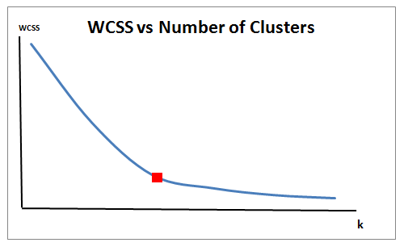
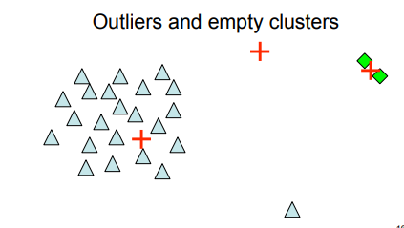
A normal distribution such that the mean μ = 0 and standard deviation σ = 1; hence, the probability density function f(x) is given by
Closing Notes on K-Means
A normal distribution such that the mean μ = 0 and standard deviation σ = 1 for your data
K-Means algorithm converges to a local minimum:
○ Can try multiple random restarts

Slide 11
Expectation Maximization
In the expectation, or E-step, the missing data are estimated given the
observed data and
current estimate of the model parameters
In the maximization or the M-step, the likelihood function is maximized
under the assumption that the missing data are known
The estimate of the missing data from the E-step are used in lieu of the actual missing data.

Slide 12
Expectation Maximization
Assume that we have two coins, C1 and C2
Assume the bias of C1 is 𝜃1 (i.e., probability of getting heads with C1)
Assume the bias of C2 is 𝜃2 (i.e., probability of getting heads with C2)
We want to find 𝜃1, 𝜃2 by performing a number of trials (i.e., coin tosses)

Slide 13
Expectation Maximization
So far we have kind of looked at EM
Lets look at a real EM using a binomial model
A coin experiment
Suppose your friend has posed a challenge:
Estimate the bias of two coins in her possession.
They might be fair coins, be more heavily weighted towards heads; you don't know.
Here's the clue she's provided: a piece of paper with 5 records of an experiment where she's:

Slide 14
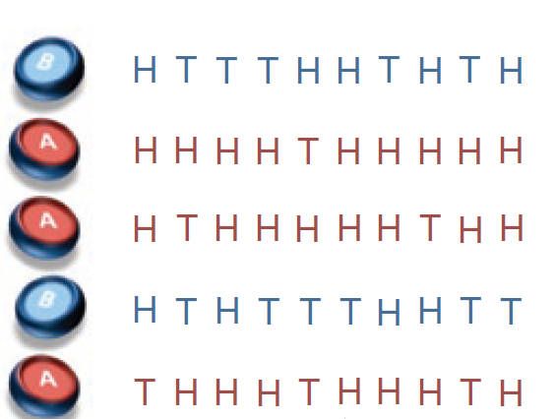
Expectation Maximization
Chosen one of the two coins at random.
Flipped that same coin 10 times.
How can you provide a reasonable estimate of each coin bias? Let's refer to these coins as coin A and coin B and their bias as θA and θB.

Slide 15
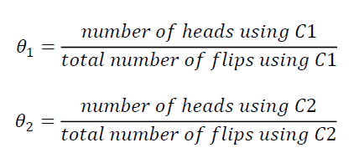
Expectation Maximization

Slide 16
Expectation Maximization
Thus : (If A represents θ₁ and B represents θ₂)
θ₁ = 24/30 = 0.8
θ₂ = 9/20 = 0.45

Slide 17
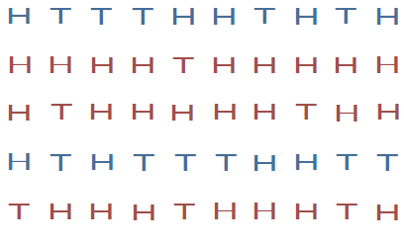
Expectation Maximization
Assume a more challenging problem. We do not know the identities of the coins used for each set of tosses (we treat them as hidden variables).

Slide 18
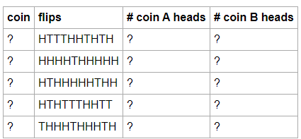
Expectation Maximization
This can be modelled as a binomial distribution .
Each trail belongs to either Coin A or Coin B
We only know that each coin has an equal chance of being chosen each time.
In this scenario, the coin is not observed, and could be considered a hidden or latent variable
This is the setup

Slide 19
Expectation Maximization
Right now we're stuck, because we'd like to count up the number of heads for each coin, but we don't know which coin is being flipped in each trial.
It turns out that we can make progress by starting with a guess for the coin biases
Which will allow us to estimate which coin was chosen in each trial and come up with an estimate for the expected number of heads and tails for each coin across the trials (E-step)
We then use these counts to recompute a better guess for each coin bias (M-step)
By repeating these two steps, we continue to get a better estimate of the two coin biases and converge at a solution that turns out to be a local maximum to the problem.

Slide 20

Expectation Maximization
Estimating likelihood each coin was chosen
Estimate the probability that each coin is the true coin given the flips we see in the trial
Which will allow us to estimate which coin was chosen in each trial .
Use that to proportionally assign heads and tails counts to each coin.
Let's make this concrete with one of the examples we just mentioned:
Lets initially guess that
our current biases for coin A and B are 0.4 and 0.7
we observe the following flips: HHHHHHHHTT
what is the probability that these flips came from coin A and coin B? Let's call this series of flips event E, the event we chose A be Z_{A} and B Z_{B}.
Both coin are equally likely to be chosen to P(Z_{A}) = P(Z_{B}) = 0.5
Now we need to estimate the P(E|Z_{A}) and P(E|Z_{B}) for example P(HHHHHHHHTT|Z_{A})
Recollect since there are only 2 choices we could use

Slide 21


Expectation Maximization
It looks like the first trail came from Coin B
But what we wish to find is P(Z_{A}|E) and P(Z_{B}|E)

Slide 22

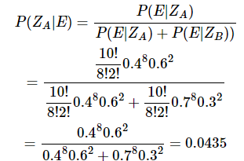

Expectation Maximization
P(Z_{A})=P(Z_{B})=0.5
We can eliminate the values from the equation
Thanks to Baye's theorem and the law of total probability, we can partition all of the events in Z (which coin we choose) over ZA and ZB as we have to choose one or the other.

Slide 23
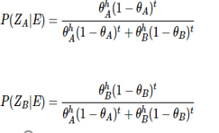
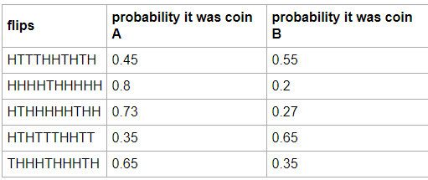

Expectation Maximization
Lets do a full cycle for one set of trails

Slide 24
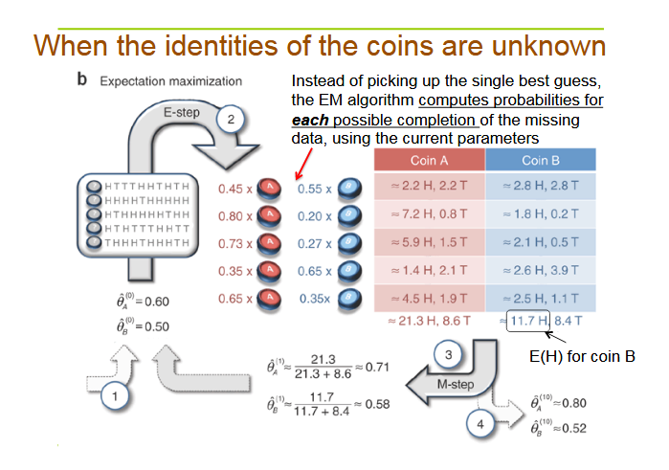

Slide 25
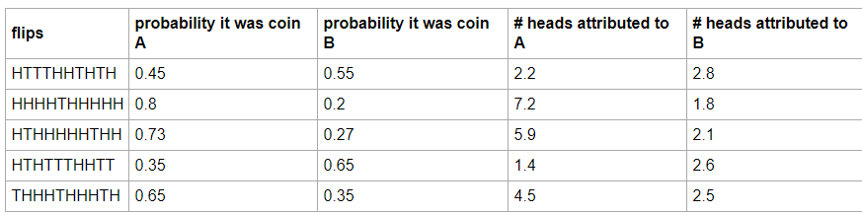

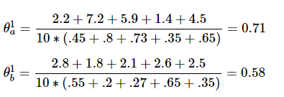
Expectation Maximization

Slide 27
MACHINE
INTELLIGENCE
EXPECTATION MAXIMIZATION - GMM
K.S.Srinivas
Department of Computer Science
and Engineering

Slide 28
Machine Intelligence
Unit III
Gaussian Mixture Models
Srinivas K.S
Department of Computer Science

Slide 29
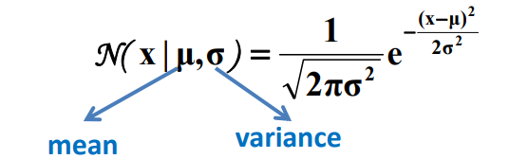
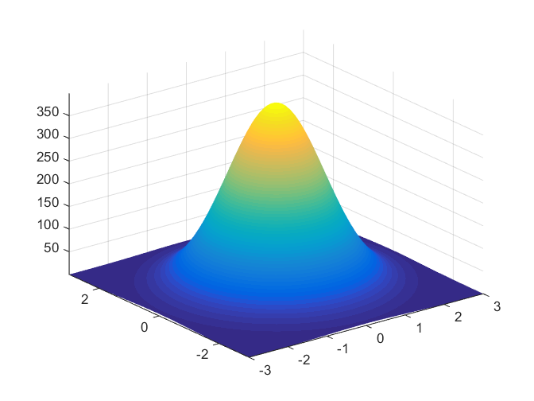
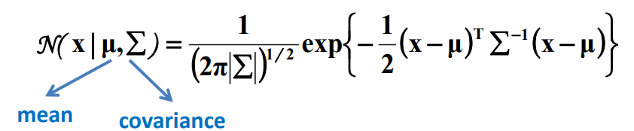
Gaussian Distributions
Univariate Gaussian Distribution
Multivariate Gaussian Distribution
A multivariate normal distribution is a vector in multiple normally distributed variables, such that any linear combination of the variables is also normally distributed.

Slide 30

Gaussian Mixture Models
We need to estimate these parameters of a distribution
One method – Maximum Likelihood (ML) Estimation.

Slide 31
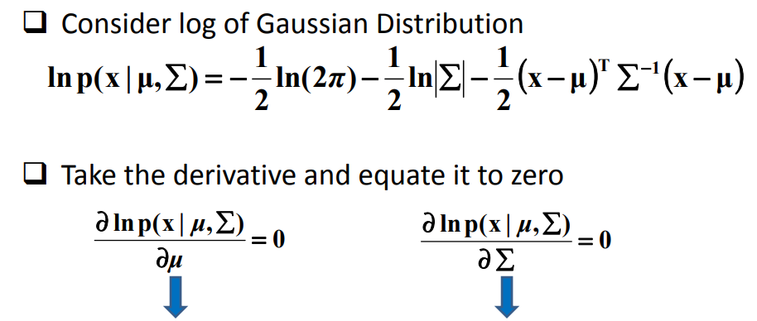
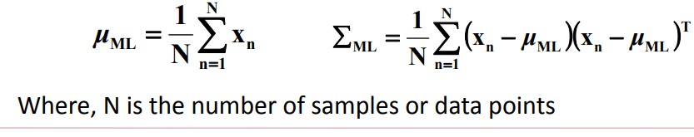
Gaussian Mixture Models

Slide 32
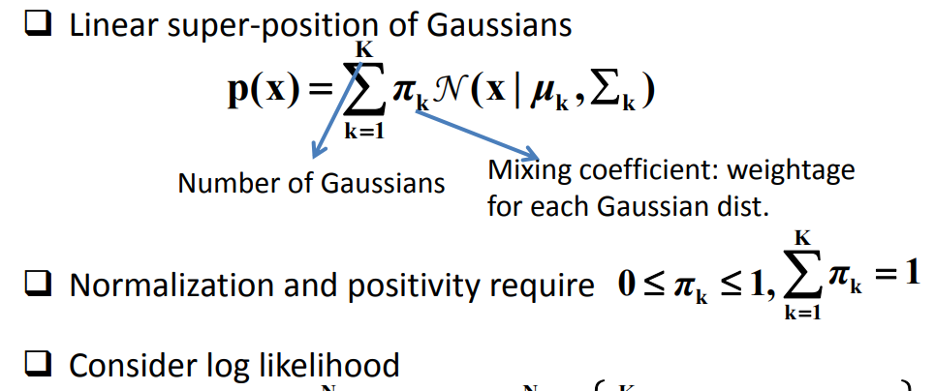
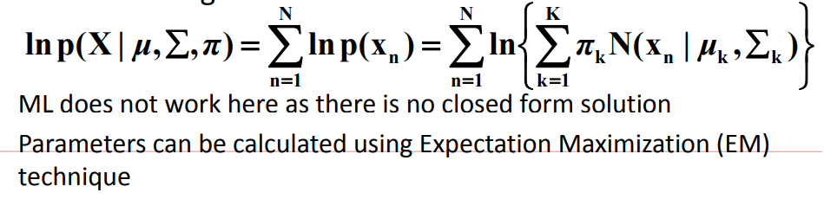
Gaussian Mixture Models

Slide 33
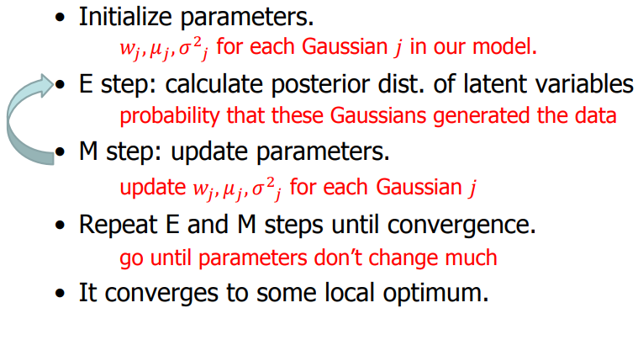
Gaussian Mixture Models – The Algorithm
Lets understand this using a 1-d example

Slide 34
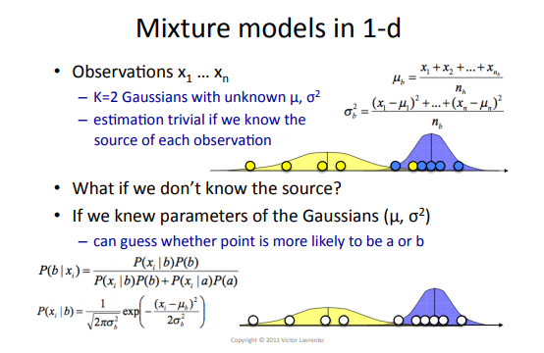
EM-GMM Example

Slide 35
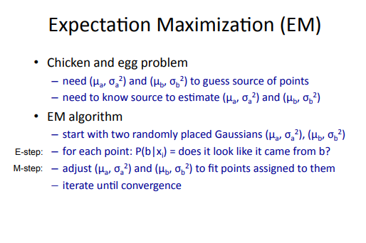
EM-GMM Example

Slide 36
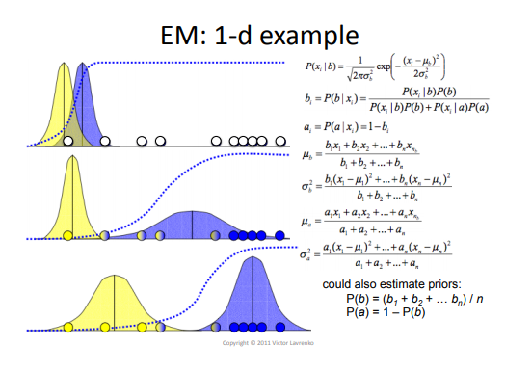
EM-GMM Example

Slide 37
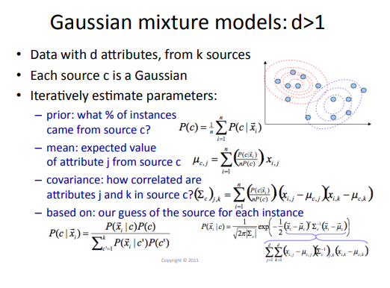
D>1 Example

Slide 38
Applications
Estimating parameters of a Gaussian Mixture model.
Baum Welch Algorithm in Hidden Markov Models.
Clustering.

Slide 39
THANK YOU
Srinivas K S
Department of Computer Science & Engineering
srinivasks@pes.edu

